Slide 1
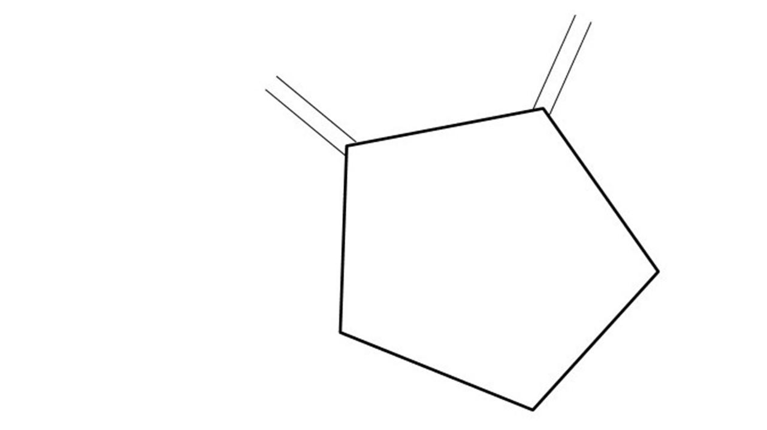
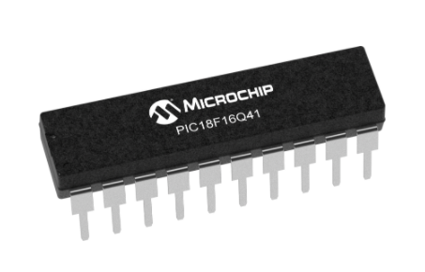
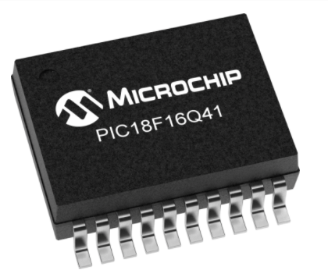
Great Cow BASIC Part 4
Great Cow BASIC for the PIC18FxxQ41 chip Family
January 2021

Slide 2
PIC18FxxQ41
PIC18-Q41 is a high performance PIC18
Digital and Analog peripherals
12-bit ADC
Multiple communication interfaces
Serial, I2C, SPI
PWM – CCP/PWM and 16Bit
Configurable Logic Cells
The PIC18xxQ41 offers 14- and 20-pin products in small footprint packages to support customers in a variety of space constrained and sensor node applications.

Slide 3
Videos...
Install the hardware and make the board work – three LED programs
Make four LEDs flash in a sequence
Set the LEDs to represent the value of ADC
Sequence the LEDs with a delay using the value of ADC
Using an input to set the state of the LEDs
Using the reset switch
Using the switch, ADC – may the LEDs flash in a sequence with reverse
Using the serial to display values
Using the timer0 overflow, 8bit timer, 16bit timer to flash the LEDs
Using CCP/PWM to dim the LEDS
Using I2C with serial to discover I2C devices
Using EEProm – showing values on the serial terminal
Using an I2C GCLD display
Using an SPI GCLD display
Using PWM to dim the LEDS
Using memory within the PIC – Progmem and SAF memory
The Great Cow BASIC tool chain
Assembly and alternatives assemblers
Summary

Slide 4
Great Cow BASIC Compiler
Great Cow BASIC is an Open Source compiler for PIC and AVR microcontrollers
Great Cow BASIC now supports the 18FxxQ41 chip family
Great Cow BASIC Compiler

Slide 5
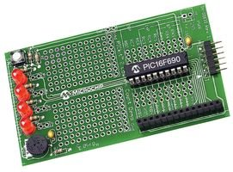
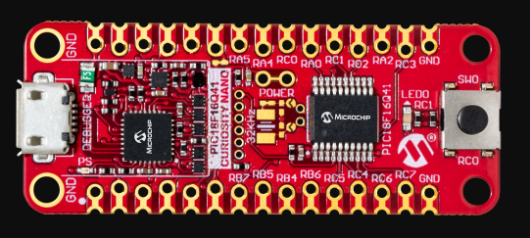

Hardware
Microchip Low Pin Count Demo Board
PICKit_2_Low_Pin_Count_User_Guide_51556a.pdf

Slide 6
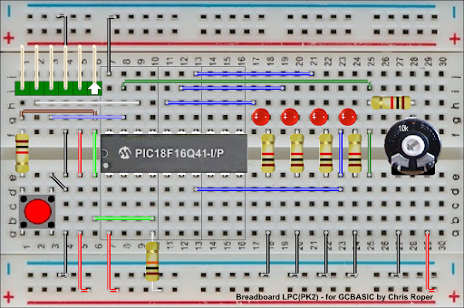
Hardware
Layout
By Chris Roper

Slide 7
Time
The tutoral combines previous tutorials by using the Analog-to-Digital Converter (ADC) to control the speed of rotation.
Where speed is a time delay
us, 10us, ms, 10ms, s, m or h
wait time unit
wait 1 ms

Slide 8
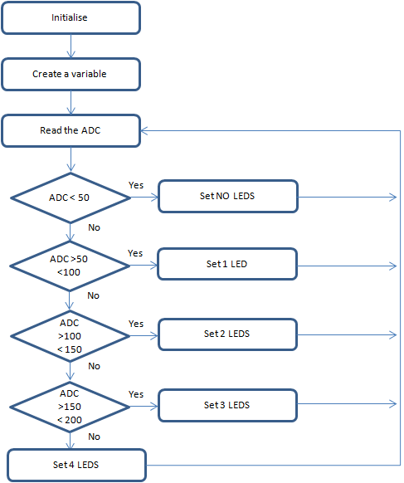
Analog-to-Digital
Great Cow BASIC completes the initialisation
Create a variable to store the ADC results
Read the ADC
Great Cow BASIC makes the process easy via the ReadADC12()
ReadADC12 returns a value of 0 to 4095
Wait for a time period based on ADC
Set the LEDs
Do it again….

Slide 9
Wait
Initialise
Set 1st LED
Time delays are sometimes key to the operation of a program
Read ADC 12 bit
( 0 – 4095 )
Wait for a Delay
Rotate the LEDs
Did it overflow ?
No
Yes
Set 1st LED

Slide 10
Lab
Examine the sample code
Review the results

Slide 11
Scale
Initialise
Set 1st LED
Scale transforms an existing value to a new value within a specified scale
Read ADC
Wait for a Delay
Scale
Rotate the LEDs
Did it overflow ?
No
Yes
Set 1st LED

Slide 12
Lab
Revise the sample code
Review the results

Slide 14
Videos...
Install the hardware and make the board work – three LED programs
Make four LEDs flash in a sequence
Set the LEDs to represent the value of ADC
Sequence the LEDs with a delay using the value of ADC
Using an input to set the state of the LEDs
Using the reset switch
Using the switch, ADC – may the LEDs flash in a sequence with reverse
Using the serial to display values
Using the timer0 overflow, 8bit timer, 16bit timer to flash the LEDs
Using CCP/PWM to dim the LEDS
Using I2C with serial to discover I2C devices
Using EEProm – showing values on the serial terminal
Using an I2C GCLD display
Using an SPI GCLD display
Using PWM to dim the LEDS
Using memory within the PIC – Progmem and SAF memory
The Great Cow BASIC tool chain
Assembly and alternatives assemblers
Summary

Slide 15
Great Cow BASIC
Great Cow BASIC for the PIC18FxxQ41 chip Family
January 2021

Slide 16
Backup Slides

Slide 17
Initialise
Set 1st LED
Wait for a Delay
Rotate the LEDs
Did it overflow ?
No
Yes
Set 1st LED

Slide 18
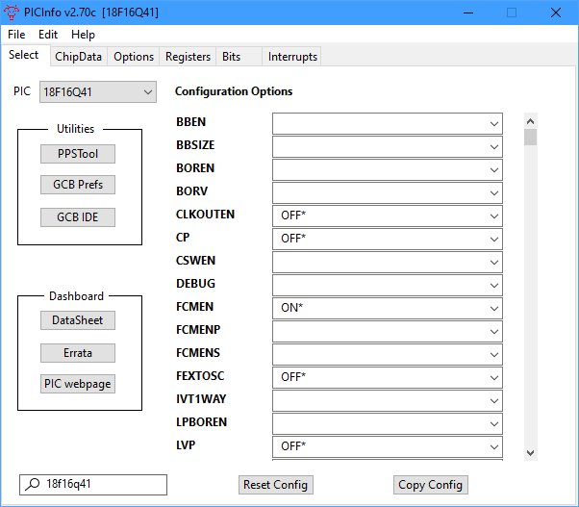
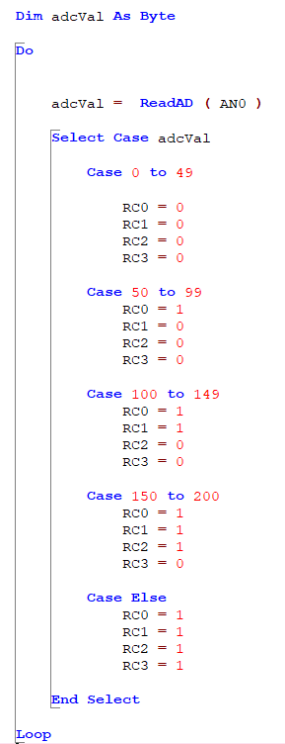
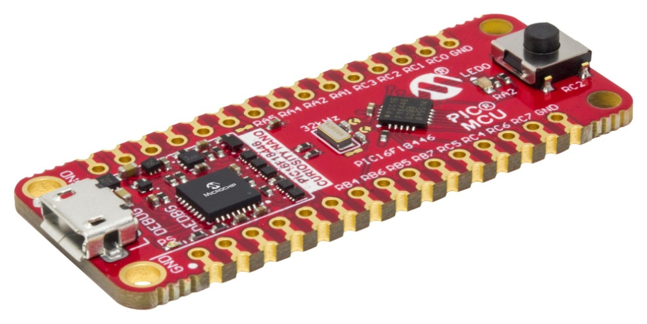
Analog-to-Digital

